Slide 1
Criminal Profiling Using OSINT(Environmental & Infrastructure Crimes)
CSE7101- Capstone Project
Review-1
Batch Number:
Under the Supervision of,
Dr./Mr./Ms./Prof.
Professor / Associate Professor / Assistant Professor
School of Computer Science and Engineering
Presidency University
Roll Number | Student Name
20221CSE0013 | Albin Joy
20221CSE0016 | Shasank M
20221CSE0059 | Madhan D
Name of the Program:
Name of the HoD: Refer- Annexure-1
Name of the Program Project Coordinator: Refer- Annexure-1
Name of the School Project Coordinators: Dr. Sampath A K , Dr. Geetha A

Slide 2
Problem Statement Number:
Organization:
Category (Hardware / Software / Both) : Software
Problem Description:
Illegal environmental crimes cause severe climate and ecosystem damage.
These crimes leave open-source digital traces (social media, domain records, news).
Existing detection pipelines are fragmented and manual.
We aim to automate OSINT collection, analysis, and profiling.

Slide 3
Content
Problem Statement
Objectives
Background and Related work for title Selection
Analysis of Problem Statement
Innovation or Novel Contributions
Git-hub Link
Timeline of the Project
References

Slide 4
Problem Statement
Illegal environmental crimes cause severe climate and ecosystem damage.
These crimes leave open-source digital traces (social media, domain records, news).
Existing detection pipelines are fragmented and manual.
We aim to automate OSINT collection, analysis, and profiling.

Slide 5
Scope & Objectives
Focus on public OSINT data sources relevant to environmental crimes.
Objectives:
Collect OSINT from social media, news, WHOIS, satellite.
NLP for entity extraction.
Classify crime type.
Generate structured profiles with risk scores.
Provide visualizations and reports.

Slide 6
Background & Related Work
Inspired by OSINT frameworks like SpiderFoot, Maltego.
NLP for entity recognition (spaCy, transformers).
Satellite imagery analysis for deforestation and pollution detection.
Gap: No integrated domain-specific OSINT tool for environmental crime profiling.

Slide 7
Analysis of Problem Statement
Scope: Focus on environmental & infrastructure crimes impacting climate; relies on public OSINT sources such as social media, news portals, WHOIS records, and satellite imagery.
Current Gaps:
Information dispersed across multiple sources and formats.
Existing OSINT tools lack specialization for environmental crime detection.
Manual methods are time-consuming and prone to oversight.
Challenges:
Integrating textual, image, and geospatial intelligence into a single system.
Ensuring compliance with legal and ethical standards in data use.
Opportunities:
Automating OSINT collection and analysis using APIs, scrapers, and NLP.
Linking entities (names, aliases, locations) to build coherent criminal profiles.
Incorporating geospatial analytics and risk scoring for prioritizing investigations.

Slide 8
Analysis of Problem Statement
Outcome:
A unified, automated profiling platform that reduces investigation time and increases accuracy in identifying suspects, associates, and crime patterns.
Opportunities:
Automating OSINT collection and analysis using APIs, scrapers, and NLP.
Linking entities (names, aliases, locations) to build coherent criminal profiles.
Incorporating geospatial analytics and risk scoring for prioritizing investigations.
Outcome:
A unified, automated profiling platform that reduces investigation time and increases accuracy in identifying suspects, associates, and crime patterns.

Slide 9
Innovation & Novelty
Domain-focused OSINT pipeline for environmental/infrastructure crimes.
Hybrid evidence linking: textual + geospatial signals.
Explainable risk scoring system.
NGO-ready, exportable investigation reports.

Slide 10
Technology Stack
Backend: Python (Flask/FastAPI)
NLP & ML: spaCy, scikit-learn, Hugging Face
Scraping/APIs: requests, BeautifulSoup, tweepy, NewsAPI
DB: MongoDB Atlas
Visualization: NetworkX, Plotly, Folium
Frontend: React or Flask+Bootstrap
Deployment: Render, Netlify

Slide 11
Github Link
The Github link provided should have public access permission.
Github Link

Slide 12
System Architecture
[Architecture diagram placeholder – to be inserted in final version]
Modules: Data Collection → Processing → Profiling → Visualization → Reporting

Slide 13
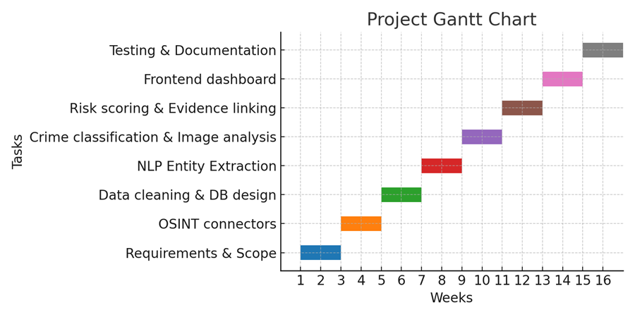
Timeline of the Project (Gantt Chart)

Slide 14
Expected Deliverables
Phase-1: Scope definition, literature survey, initial connectors.
Phase-2: NLP + Classification models.
Phase-3: Risk scoring, visualization, frontend dashboard.
Final: Fully functional OSINT profiling platform + documentation.

Slide 15
References
[1] Aldridge, J., & Price, M. Open-source intelligence techniques in law enforcement, 2020.
[2] Smith, M., & Jones, L. Detecting illegal logging using satellite imagery, 2021.
[3] Thompson, R. et al. OSINT automation for cyber threat intelligence, 2020.

Slide 16


